Slide 1
HEART DISEASE DIAGNOSTIC-ANALYSIS
Prakhyat Nandan Srivastava
Detailed Project Report

Slide 2
Project Information
PREV
NEXT
Project Title | Heart Disease Diagnostic - Analysis
Technologies | Business Intelligence
Domain | Healthcare
Project Difficulties level | Advanced

Slide 3
Project Objective
PREV
NEXT
The objective of this project is to examine the incidence of heart disease, utilizing a set of characteristics that collectively describe the condition. This analysis aims to identify patterns and correlations that could enhance our understanding of heart disease and potentially aid in its prevention

Slide 4
Problem Statement
PREV
NEXT
In the wake of the global pandemic, the importance of health has been underscored like never before. Heart disease, being one of the leading causes of death worldwide, requires particular attention. The challenge is to analyze a heart disease diagnostic database to extract meaningful insights. The analysis should focus on understanding the occurrence of heart disease based on various health metrics such as age, gender, blood pressure, cholesterol levels, and maximum heart rate.
The goal is to identify patterns and correlations that could enhance our understanding of heart disease and potentially aid in its prevention. The project also involves the creation of a comprehensive dashboard to effectively visualize these insights. However, the data requires careful extraction, transformation, and loading (ETL), and the exploratory data analysis (EDA) process needs to be meticulous to ensure the reliability of the findings.

Slide 5
ARCHITECTURE
PREV
NEXT

Slide 6
Overview of Dataset
PREV
NEXT
This dataset comprises several clinical attributes used to assess the likelihood of heart disease:
Age: The patient's age in years.
Sex: The patient's gender (1 = male, 0 = female).
Chest Pain Type (cp): Categorized into four types:
1: Typical angina
2: Atypical angina
3: Non-anginal pain
4: Asymptomatic
Resting Blood Pressure (trestbps): Measured in mm Hg at hospital admission.
Cholesterol (chol): Serum cholesterol level in mg/dl.

Slide 7
Overview of Dataset (Continued ….)
PREV
NEXT
Fasting Blood Sugar (fbs): Indicates if fasting blood sugar is over 120 mg/dl (1 = yes, 0 = no).
Resting ECG (restecg): Resting electrocardiographic findings:
0: Normal
1: ST-T wave abnormality (inversions and/or ST elevation/depression > 0.05 mV)
2: Likely left ventricular hypertrophy (Estes' criteria)
Max Heart Rate (thalach): Peak heart rate achieved during testing.
Exercise-Induced Angina (exang): Occurrence during exercise (1 = yes, 0 = no).

Slide 8
Overview of Dataset (Continued ….)
PREV
NEXT
ST Depression (oldpeak): Measured in mm, induced by exercise relative to rest.
ST Segment Slope (slope) during peak exercise:
1: Upsloping
2: Flat
3: Downsloping
Major Vessels (ca): Number of major vessels seen in fluoroscopy (0-3).
Thallium Stress Test (thal):
3: Normal
6: Fixed defect
7: Reversible defect
Disease Diagnosis (num): Angiographic disease status, ranging from no disease (0) to varying degrees (1-4).

Slide 9
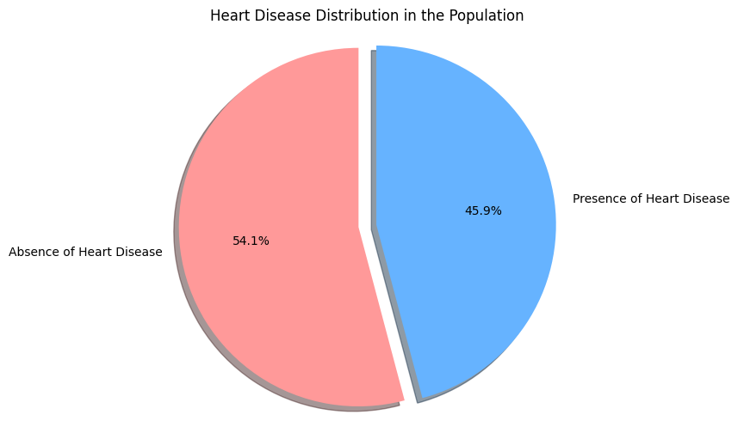
Data Visualization Insight
PREV
NEXT
The pie chart shows that out of the studied population, 54.1% do not have heart disease, while 45.9% do.

Slide 10
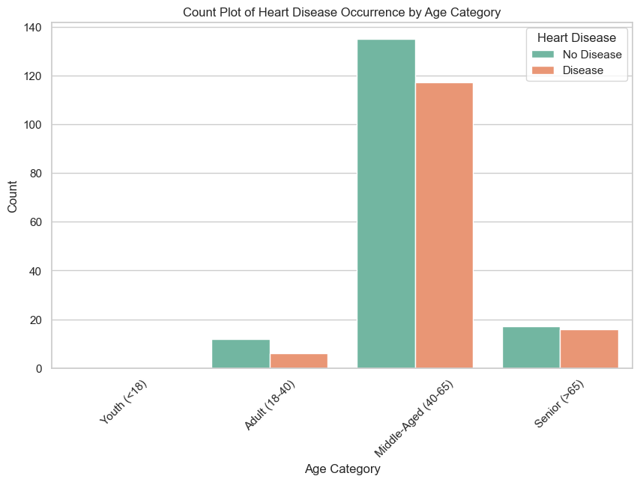
Data Visualization Insight (Continued ….)
PREV
NEXT
The count plot shows heart disease occurrence increases with age, peaking in the middle-aged group, with lower incidence in the young and senior categories.

Slide 11
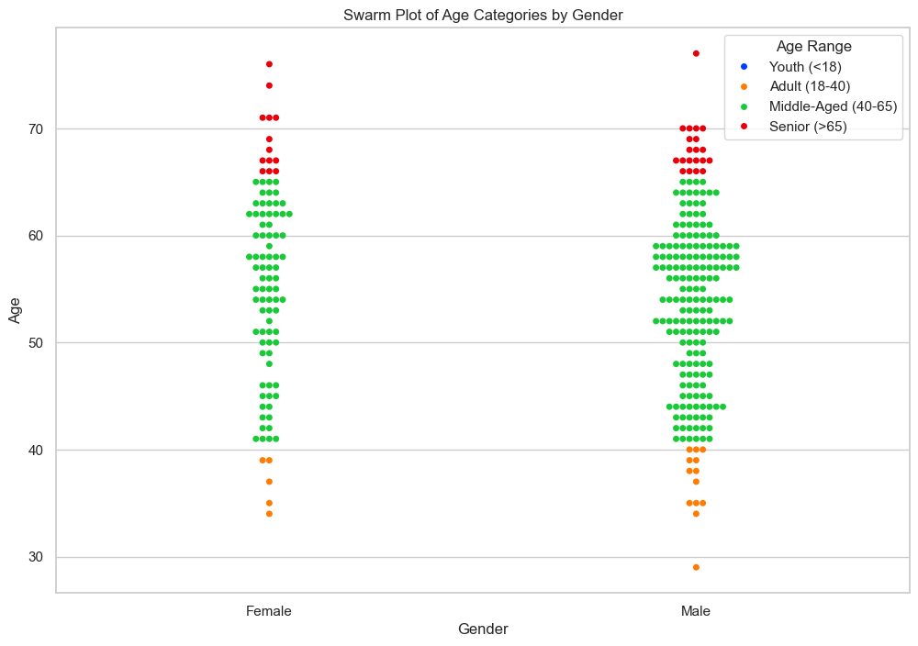
Data Visualization Insight (Continued ….)
PREV
NEXT
The swarm plot indicates both genders have a similar age distribution in heart disease studies, with fewer youths and a concentration in middle-aged to senior categories.

Slide 12
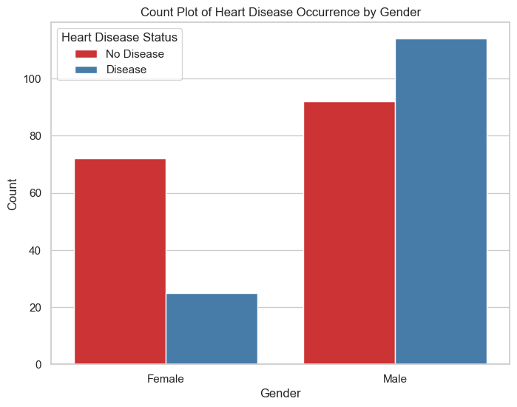
Data Visualization Insight (Continued ….)
PREV
NEXT
The plot reveals a higher count of heart disease occurrence in males compared to females.

Slide 13
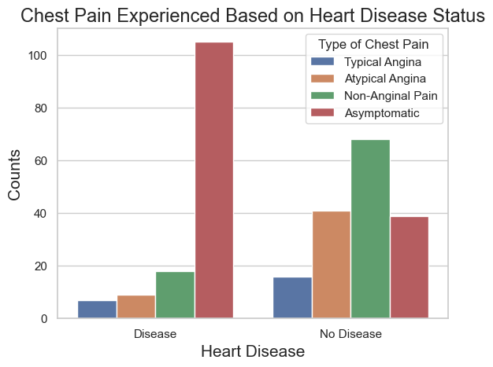
Data Visualization Insight (Continued ….)
PREV
NEXT
Asymptomatic chest pain is predominant among individuals without heart disease, while typical angina is most common in those with the disease.

Slide 14
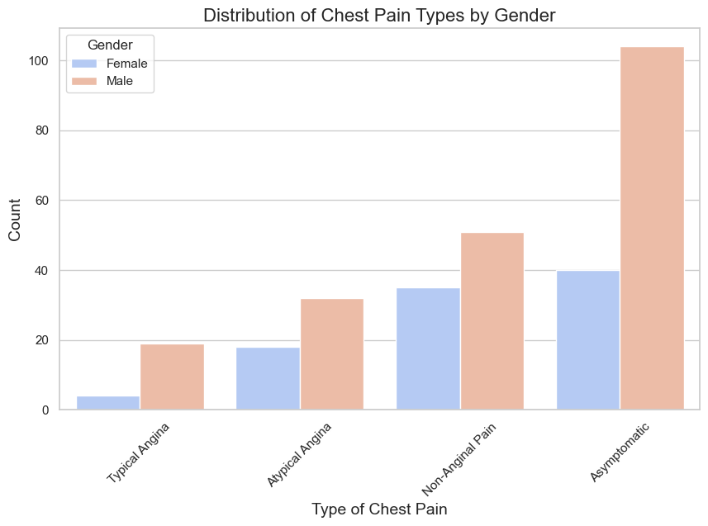
Data Visualization Insight (Continued ….)
PREV
NEXT
Asymptomatic chest pain is more common in males, while females report more atypical angina and non-anginal pain.

Slide 15
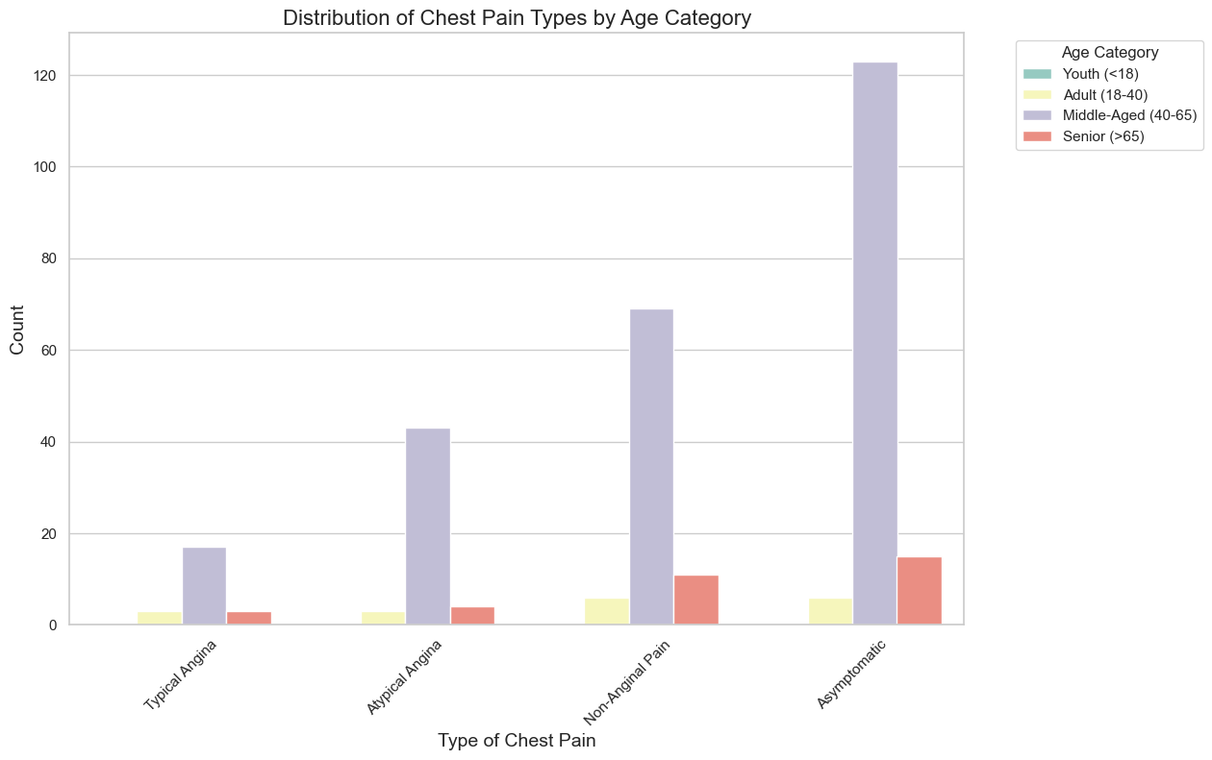
Data Visualization Insight (Continued ….)
PREV
NEXT
The distribution suggests that asymptomatic chest pain is most reported in the middle-aged group, with other types of pain being less common across all age categories.

Slide 16
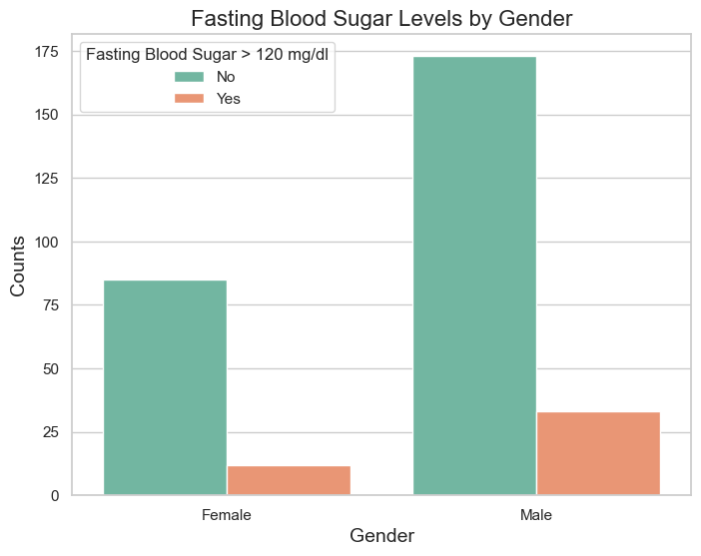
Data Visualization Insight (Continued ….)
PREV
NEXT
More males than females have fasting blood sugar levels above 120 mg/dl.

Slide 17
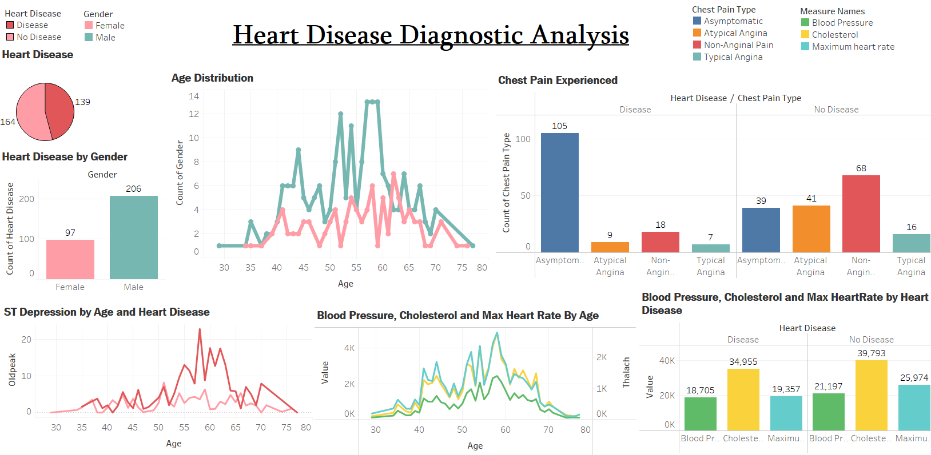
Dashboard

Slide 18
Conclusion
PREV
NEXT
Approximately 45.87% of the studied population is affected by heart disease.
The prevalence of heart disease is higher among men aged 50 to 60, while for women it is more common between 55 to 65 years.
Males demonstrate a higher susceptibility to heart disease compared to females.
The risk of heart disease increases with age, particularly in the elderly demographic.
Asymptomatic chest pain is strongly associated with an increased risk of heart disease.
Individuals with heart disease often exhibit elevated cholesterol levels.
Blood pressure tends to rise in individuals between the ages of 50 and 60, and this trend may persist until the age of 70.
The 50-60 age group shows a tendency for rising cholesterol levels and peak heart rates.
ST depression, an indicator of heart stress, is most commonly observed to increase among individuals aged 30 to 40.

Slide 19
FAQ
Q1) Where did the dataset for this analysis originate?
Ans) The dataset for the heart disease analysis was sourced from the Cleveland Clinic Foundation and is part of a larger dataset available from the UCI Machine Learning Repository. ( https://archive.ics.uci.edu/ml/datasets/heart+disease )
Q2) Can you describe the type of data included in the study?
Ans) The data comprises both numerical and categorical values. Numerical data includes age, blood pressure, and cholesterol levels, while categorical data encompasses sex, chest pain types, fasting blood sugar levels, etc.
Q3) Could you outline the process you followed in this analysis?
Ans) Please see slide 5 for a detailed flowchart of the analysis process, which includes data cleaning, exploratory data analysis, and statistical analysis.
Q4) What specific data preprocessing techniques did you employ?
Ans) Data preprocessing involved removing unwanted attributes, detecting and handling outliers, imputing missing values, and converting numerical data into categorized formats where appropriate.
Q5) Which Python libraries were integral to your analysis?
Ans) The primary libraries utilized were Pandas for data manipulation, NumPy for numerical computations, and Matplotlib and Seaborn for data visualization.
Q6) How did you address missing data within the dataset?
Ans) Missing values were addressed by imputing with median values, as it is a robust measure of central tendency.
Q7) What strategies were employed to manage outliers in the data?
Ans) Outliers were managed by applying the Interquartile Range (IQR) method, setting bounds to identify and handle extreme values.
Q8) How did you convert numerical data into categorical values, and why?
Ans) Numerical data was categorized to facilitate analysis on categorical groupings, such as age ranges or categories of chest pain, using binning techniques and mapping to descriptive labels.

Slide 20
THANK YOU!
PREV
NEXT

